Slide 1
My AI for StarCraft II
Patryk Steckel

Slide 2
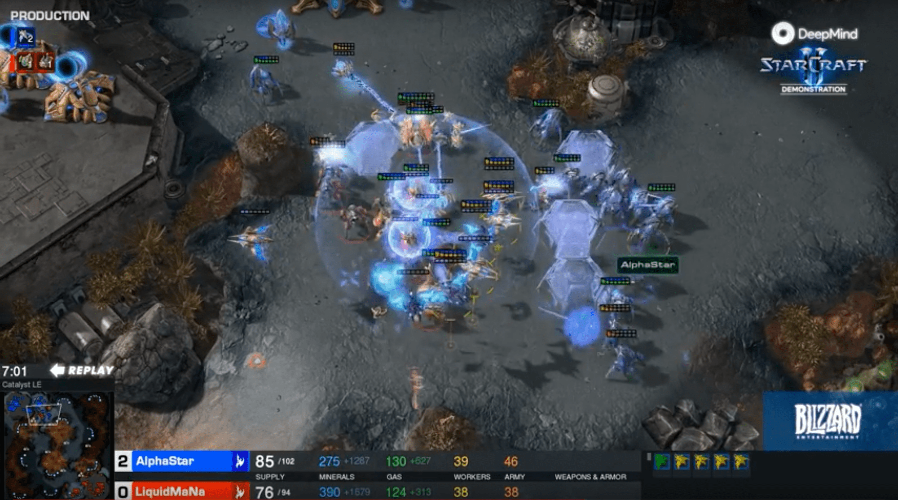
StarCraft II
Objective:
Destroy the opponent’s base
How?
Gather resources
Build an army
Research technologies
Attack
A case for RL
Game theory
Imperfect information
Long term planning
Real time
Large action space

Slide 3
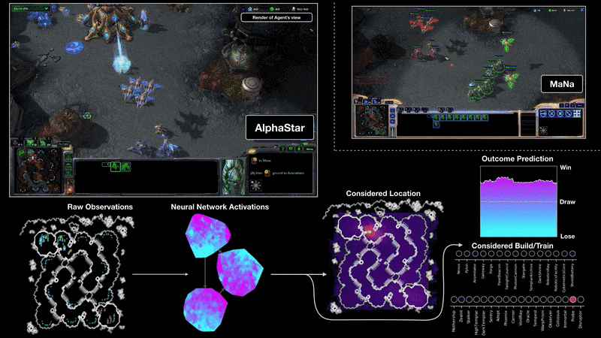
AlphaStar

Slide 4
Prerequisites
StarCraft II
Game logic
Rendering
PySC2
Game state
Action
Result
Gym
Base RL classes: Env
StableBaselines3
RL algorithms: PPO
Utils

Slide 5
Components
Custom Env
PySC2
Observation
Agent
StarCraft II
Action
Reward

Slide 6
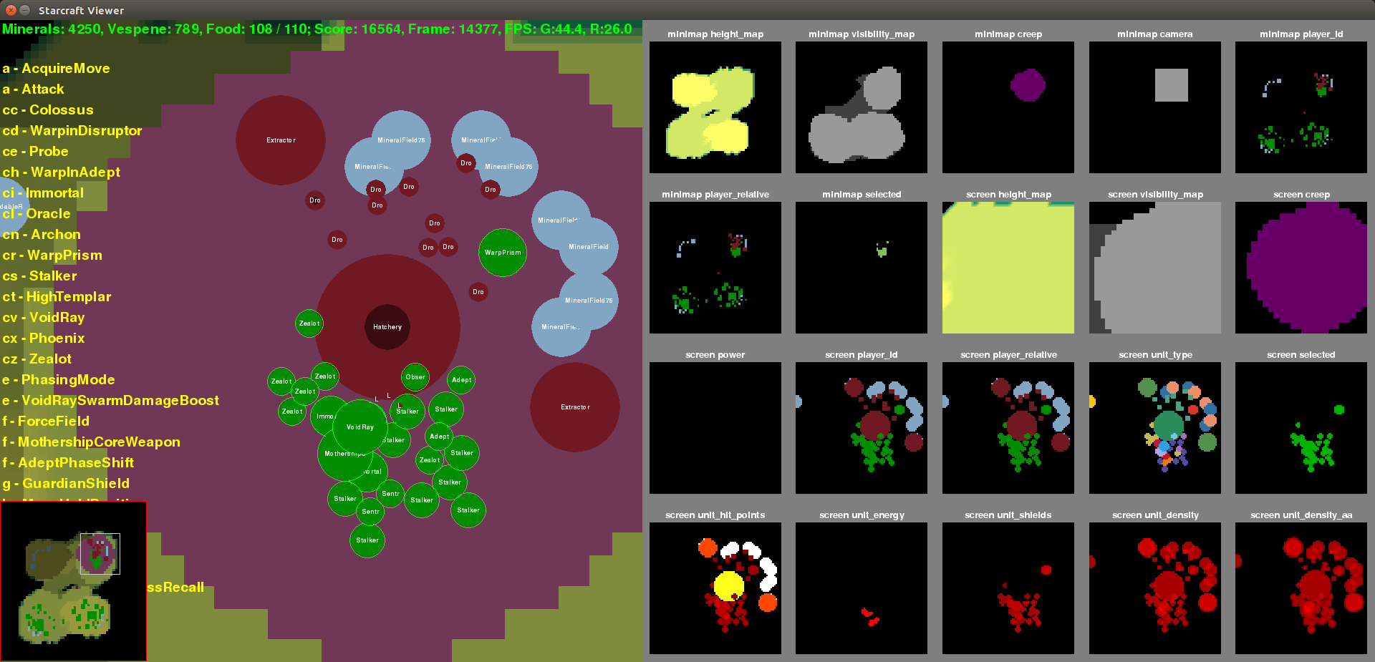
Game state
Spatial
Minimap
Fog of war
Ownership
Terrain
Screen
Object type (Marine, Barracks)
State (health, energy etc.)
Non-spatial
Resources (Minerals, Gas, Supply)
Object information (type, health, position)
Upgrades

Slide 7
Actions
Large action space:
Action ID
563 different actions
E.g., Build Barracks, Train Marine, Research Infantry Weapons, Attack
Object to command
Unit
E.g., Marine, SCV,
Building
E.g., Barracks, Engineering Bay
Target
Location
E.g., (26, 57)
Object
E.g., Marine, Barracks

Slide 8
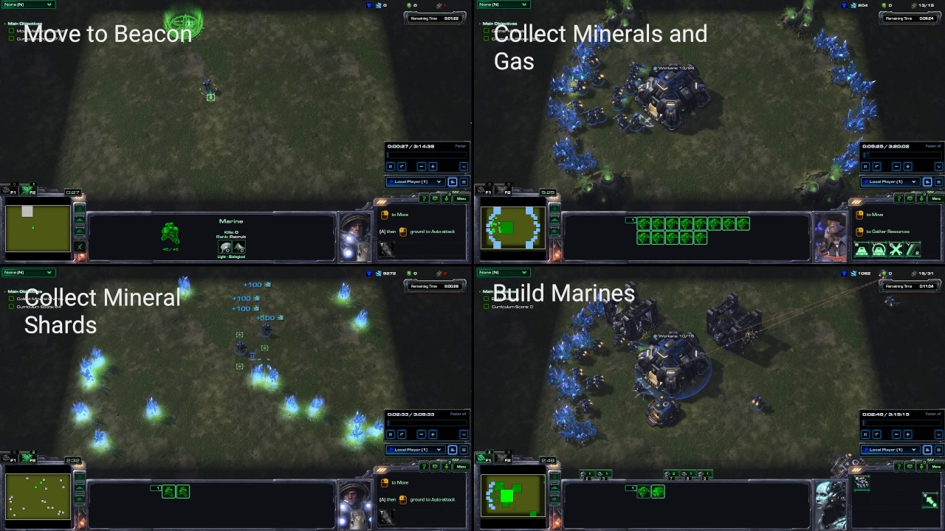
Minigames
Move to Beacon
Collect Mineral Shards
Collect Minerals And Gas
Build Marines
Defeat Zerglings And Banelings

Slide 9
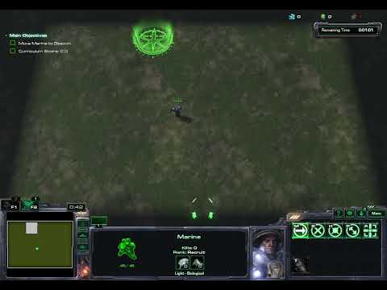
MoveToBeacon
A unit has to reach target. Then the target changes its position.
https://www.youtube.com/watch?v=GNmzKSUd_uU

Slide 10
MoveToBeacon
The unit has to reach the target. Then the target changes its position.
Environment:
Observation
Position of the unit and the target
4 numbers [0.0, 1.0]
Action
Where the unit must go
2 numbers [0.0, 1.0]
Reward
1 every time the unit reaches the target
End
2 minutes

Slide 11
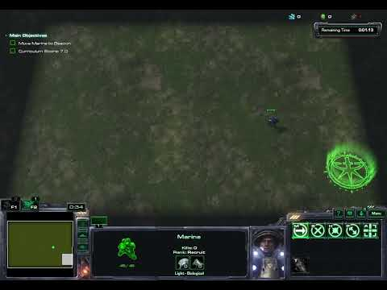
MoveToBeacon
Trained agent

Slide 12
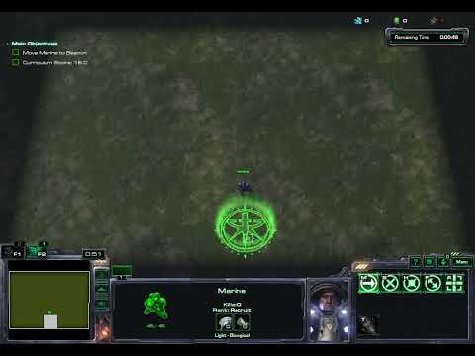
MoveToBeacon
Algorithm: Target position => Action

Slide 13
MoveToBeacon
Results
Random | <1
Trained | 24
Algorithm | 25
AlphaStar | 26

Slide 14
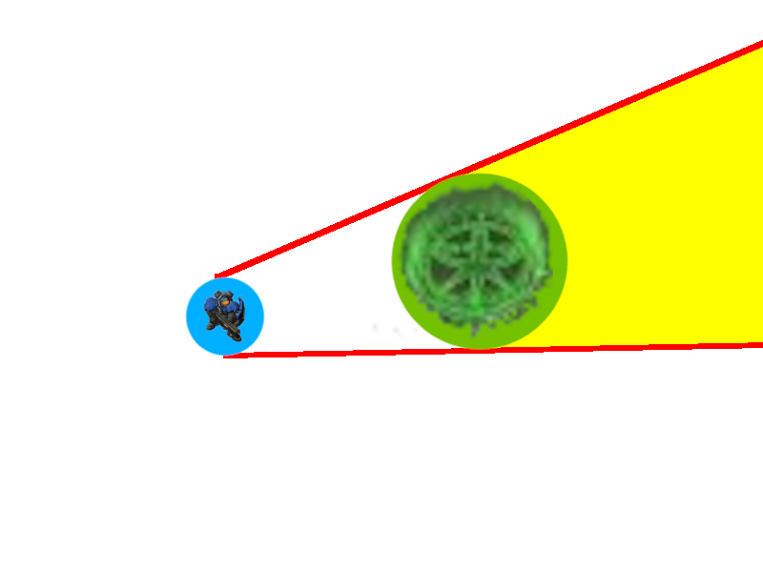
MoveToBeacon
Reward structure
Valid destination
Unit
Target

Slide 15
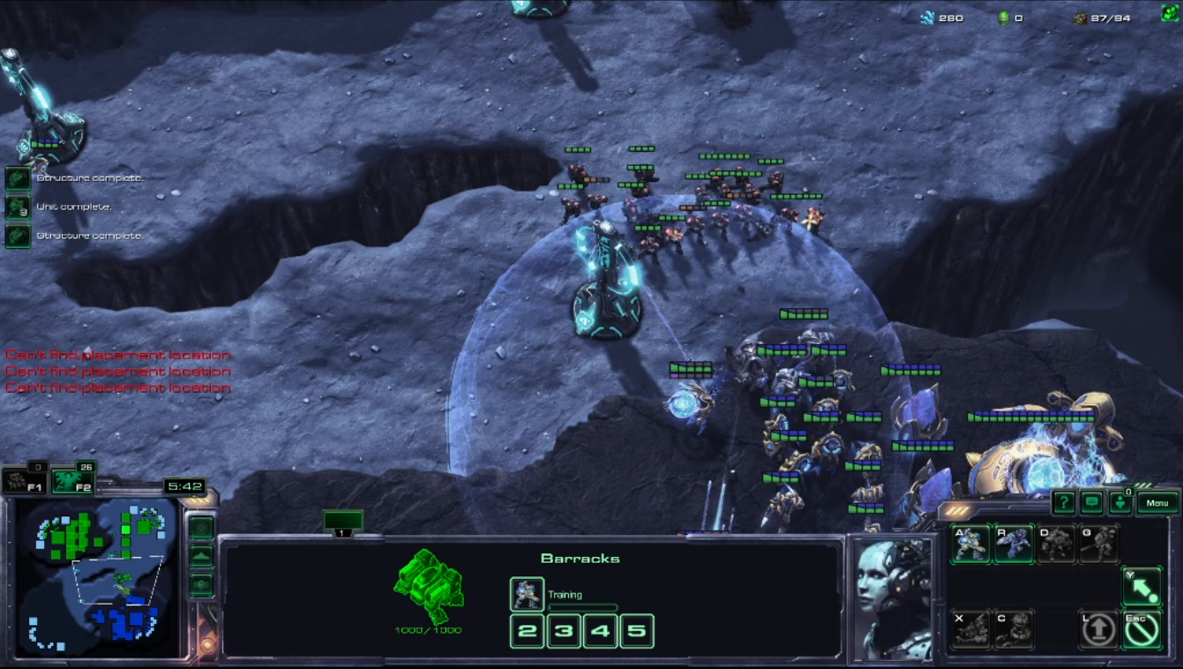
Full game
Small map
Agent
Race: Terran
Enemy
Race: Random
Difficulty: varies
Steps: 5k
Can be shorter if win/lose

Slide 16
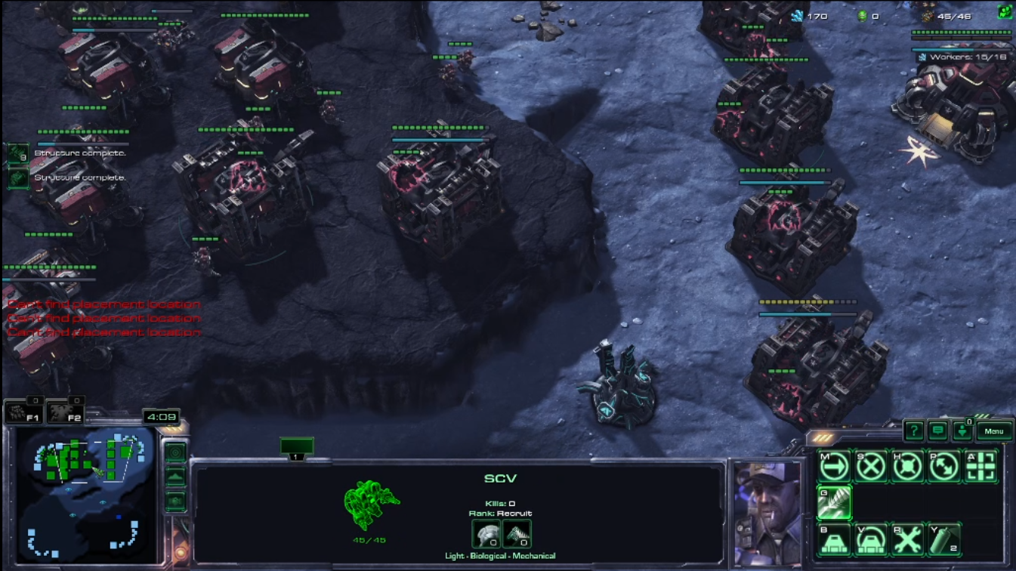
Actions
Discrete action space
One of 16 actions:
BUILD_MARINE
BUILD_SCV
BUILD_SUPPLY
BUILD_BARRACKS
BUILD_CC
ATTACK
STOP_ARMY
RETREAT
GATHER_ARMY
NOTHING
BUILD_REFINERY
BUILD_ENGINEERING_BAY
RESEARCH_INFANTRY_WEAPONS
RESEARCH_INFANTRY_ARMOR
BUILD_FACTORY
BUILD_ARMORY
Much simpler decisions
Many less actions to choose from
No source and target for the action
Agent cannot play the game to the full potential
Sequences = Actions ^ Steps = 16 ^ 5000 = ~ 3.9 * 10 ^ 6020

Slide 17
Action masking
Actions can be not doable for given state
Not enough resources
No required building
No idle building
No army to command
Invalid actions are masked
Probability of taking a masked action is 0
Simplifies exploration
Is differentiable - backpropagation can be done
Doesn’t need to be learned (as opposed to negative reward)
https://arxiv.org/abs/2006.14171
100 Minerals
Can build?
SCV [50m]
Marine [50m]
Supply Depot [100m]
Barracks [150m]
Command Center [400m]

Slide 18
Observation
Game state features
MINERALS
SUPPLY_TAKEN
SUPPLY_ALL
SUPPLY_FREE
SCV_COUNT
TIME_STEP
SUPPLY_DEPOT_COUNT
PRODUCTION_BUILDING_COUNT
IS_BARRACKS_BUILDING
MILITARY_COUNT
CC_STARTED_BUILDING
CC_BUILT
ENEMY_RACE_TERRAN
ENEMY_RACE_ZERG
ENEMY_RACE_PROTOSS
ENEMY_PROXIMITY
REFINERY_COUNT
IS_REFINERY_BUILDING
ENGINEERING_BAY_COUNT
IS_ENGINEERING_BAY_BUILDING
INFANTRY_WEAPONS_COMPLETED
ARMORY_COUNT
FACTORY_COUNT
INFANTRY_ARMOR_COMPLETED
Action state for every action
Is it valid?
Can do it instantly?
Has enough minerals?
Has enough vespene gas?
Has required buildings?
Are required buildings idle?
Building state for every building type
Is missing?
Is building?
Is it built?
Spatial features – minimap
Terrain height
Visibility
Creep
Camera
Player ID
Player relative
Selected
Unit type
Alerts
Pathable
Buildable

Slide 19
Reward
Main reward
1 for win
0 for tie (no winner after 25 minutes)
-1 for lose
Shaped Reward
Game score * 0.0001
Resources gathered
Unit/buildings produced
Unit/buildings destroyed
Units/buildings lost (penalty)
Upgrades completed
Worker produced * 0.001
1 if needs
-1 if doesn’t need
Attack action
CC building
Supply depot building
Discount factor y=0.9999

Slide 20
Architecture
Spatial features
Conv Net
Flatten
Concat
PolicyMLP
Action
Observation vector
Non-spatial features
Value MLP
State Value

Slide 21
Algorithm
Proximal Policy Optimization (PPO): https://arxiv.org/abs/1707.06347
R: Reward
s: State
a: Action
V: State value
MSE: Mean Squared Error
A: Advantage
π_{new}, π_{old}: New and old policy
r: Ratio of policies
𝛆: Clip range
Value loss = MSE(R, V)
A = R - V
r = π_{new}(a | s) / π_{old}(a | s)
Simplified policy loss: -r * A
Clipped policy loss = -min(r * A, clip(r, 1-𝛆, 1+𝛆) * A)
Entropy loss = -entropy( π_{new}(s) )
Total loss = Value loss + Clipped policy loss + Entropy loss

Slide 22
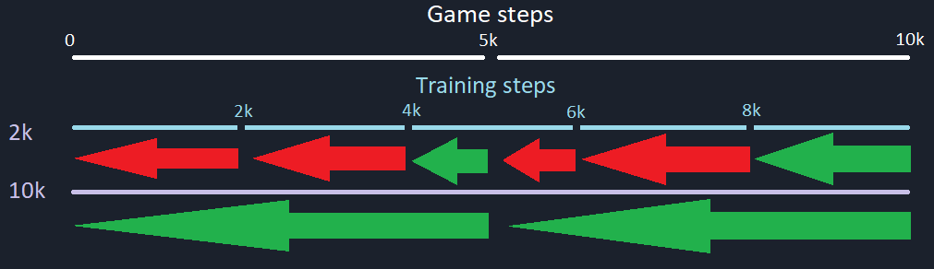
Training
Time: ~4 days on RTX 3070
No hyperparameter tuning, except:
Number of steps for training = ~2 * Number of game steps

Slide 23
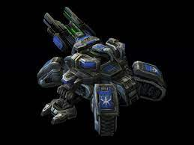
Results
Race | Terran | Zerg | Protoss
Very Easy | ✅ | ✅ | ✅
Easy | ✅ | ✅ | ✅
Medium | ✅ | ✅ | ✅
Medium-hard | ✅ | ✅ | ✅
Hard | ✅ | ✅ | ✅
Harder | 🗙 | ✅ | ✅
Very Hard | 🗙 | ✅ | ✅
+Vision | ✅ | ✅ | ✅
+Resources | ✅ | ✅ | ✅
+Stroger units | ✅ | ✅ | ✅

Slide 24
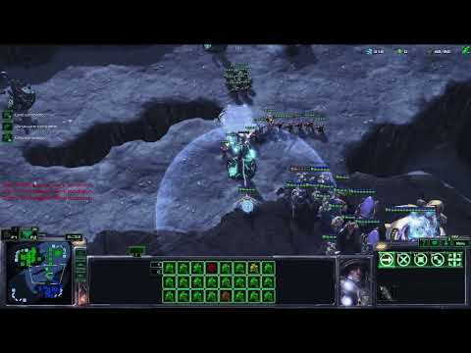
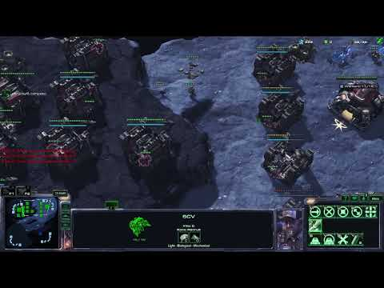
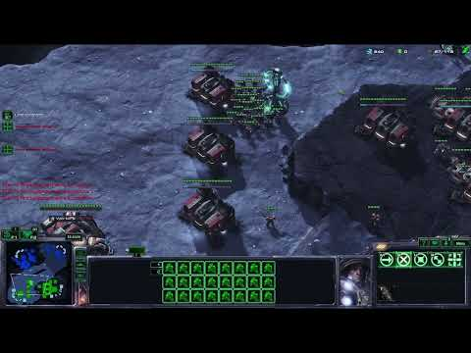
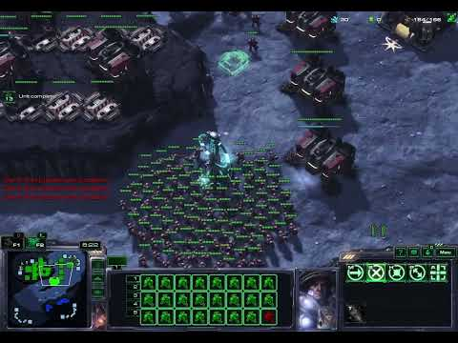
Trained agent
vs Protoss harder
vs Zerg harder
vs Terran harder (fail)
vs Terran hard

Slide 25
The end
Thank you!
https://github.com/CppMaster/SC2-AI

